Slide 1
Girl-centred HIV prevention
Sinead Delany-Moretlwe, MBBCh PhD
University of the Witwatersrand
IAS, Amsterdam, 2018

Slide 2
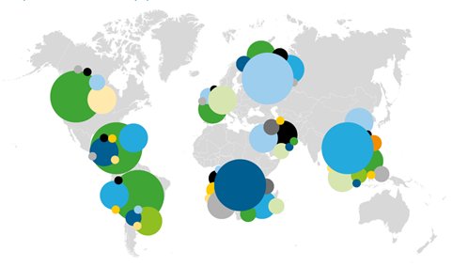
Adolescent girls and young women in sub-Saharan Africa are at high risk for HIV infection
Source: UNAIDS, 2013, www.unicef.org
Notes:
Adolescent girls and young women are a key population in eastern and southern Africa.
In high-prevalence settings, young women remain at unacceptably high risk of HIV infection.
In eastern and southern Africa, for example, young women (aged 15–24 years) accounted for 26% of new HIV infections in 2016 despite making up just 10% of the population.
In 2016, 2.1 million adolescents were living with HIV, the majority of them in sub-Saharan Africa. (84%)
Adolescent girls and young women are up to eight times more likely to be living with HIV than boys and young women of the same age.
Among those living with HIV, AIDS is now the leading cause of death among adolescents in Africa and the second most common cause of death among adolescents globally.
In fact, according to UNAIDS estimates, adolescents are the only age group in which deaths due to AIDS are not decreasing—this while all other age groups combined experienced a decline of 38% in AIDS-related deaths between 2005 and 2013 as a consequence of increasing coverage of ART.

Slide 3
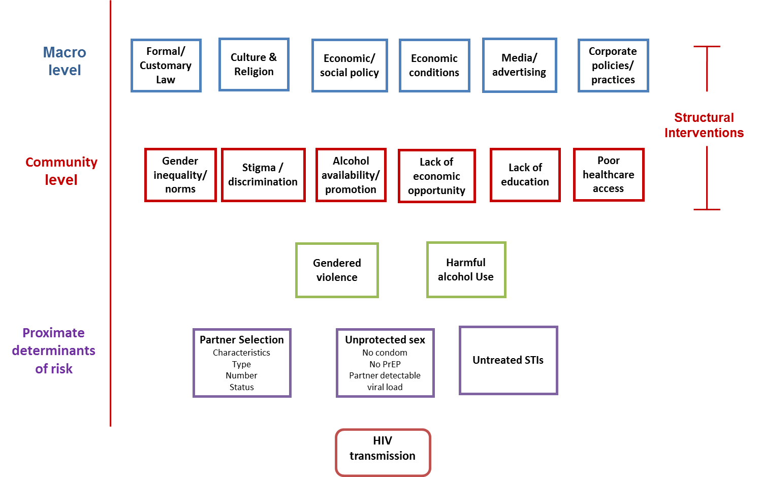
Pathways to HIV risk
Notes:
Entrenched gender inequalities limit women’s choices and create expectations of masculinity that are at odds with HIV prevention aims ^{26,27}
Poverty, economic inequality and underdevelopment undermine the capacity of populations to access and act on HIV prevention messages, as well as, for example, fuelling transactional and commercial sex ^{28,29}
Social stigmatisation of HIV/AIDS and certain types of sexual behaviour (including sex work and men having sex with men) means these behaviours have remained hidden and not addressed in behavioural HIV prevention ³¹.
Widespread alcohol availability has fuelled unsafe sex as it inhibits people’s decision-making about having sex and use of protection [cf Alc brief ].
National wealth, income inequality and access to education associated with poor adolescent health outcomes worldwide
Countries with a greater proportion of school enrolment had better health outcomes, including lower HIV prevalence
Countries with greater sex inequalities had poorer health outcomes for both sexes

Slide 4
Violence and harmful gender norms impact the treatment cascade
HIV testing
IPV was associated with inability to access care and treatment.
Viral load suppression
IPV reduced odds of women adhering to ART by half.
Partner abuse associated with poor adherence leading to poor clinical outcomes (CD4+, VL).
Increased loss to follow up
Gender inequality undermines women's decision-making autonomy about HIV testing
IPV associated with treatment discontinuation
IPV was associated with lower current ART use among women
Women were reluctant to, or did not include, their male partners in PMTCT services due to fear of violence.
Fear of IPV prevented some women from accessing testing (variable results). One study suggested that IPV motivates HIV testing.
Fear of violence prevented disclosure
ART initiation
Limited data for prevention but emerging evidence for similar patterns
Source: Kouyoumdjian, 2013; Morfaw, 2013; Musheke, 2013; Pantalone, 2014; Hatcher, 2015
Notes:
Add an icon for testing (Blood draw), ART (pills) and retention (Calendar)
When we looked at studies around the influence of violence: IPV or non-partner abuse, what we found is that gender inequality undermines women’s decisions around accessing HIV testing. In some reviews women’s fear of partner violence prevented them from actually going to HIV counselling and testing services, although some other studies showed no difference by IPV status. One study suggested that experience of violence may motivate HIV testing – so there were mixed results including evidence that fear of violence prevents disclosure.
When we looked at the effects of violence on ART initiation, what we found was that IPV was associated with reduced access to care and treatment in the majority of studies but not all, that IPV in the meta-analysis was associated with lower current use of ART and when we looked at studies that particularly reviewed PMTCT, women were often reluctant to include their male partners because of fear of violence. In terms of the last 90 in the treatment cascade, when we look at the impact of violence on adherence and retention of care, we found that IPV reduced by half adherence to ART. In one important study what we see is indication that in fact this translates into clinical outcomes; partner abuse was associated with poor medication adherence but here they also had evidence for poor treatment outcomes. Some additional studies also showed that IPV was associated with treatment discontinuation and loss to follow up.
There is a body of evidence that violence may influence the treatment cascade, but what we can start to see already from results from trials and emerging demonstration projects is that these factors are likely to also influence PrEP uptake and use.

Slide 5
Biomedical tools alone will not achieve epidemic control

Slide 6
Social and structural factors influence multiple adolescent health outcomes
Source: Population Council, 2016
… we must address these if we are to achieve the demographic dividend

Slide 7
Social and structural factors can be addressed with programmatic timeframes

Slide 8
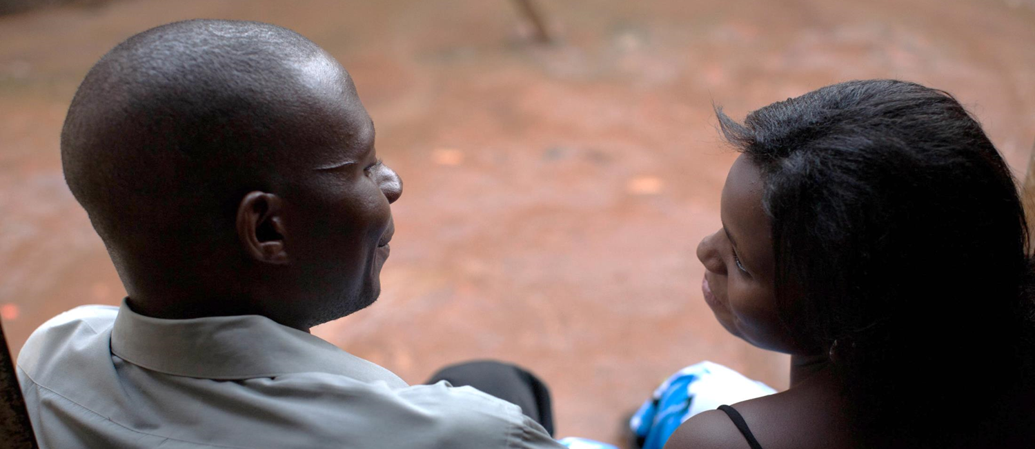


SASA!
Community mobilization approach to changing social norms that perpetuate violence against women and increase risk of HIV
Notes:
Add details

Slide 9
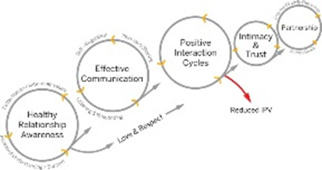
SASA! Trial conclusions
SASA! had significant community impacts on:
  Past year occurrence of physical violence among those with a history of violence (52% lower, significant)
  Attitudes towards the acceptability of violence & women being able to refuse sex
  Levels of sexual concurrency reported by men
  Women’s reported ability to refuse sex
  Promising community impacts on:
  Overall levels physical violence (52% lower, not significant)
  New occurrence of violence in relationships
  Community responses to women experiencing violence
  Direct intervention exposure not necessary to achieve benefits
  Cost approximately $1 / day per activist supported
Source: Ambramsky, 2014; Starmann, 2016
Notes:
Check timeframes

Slide 10
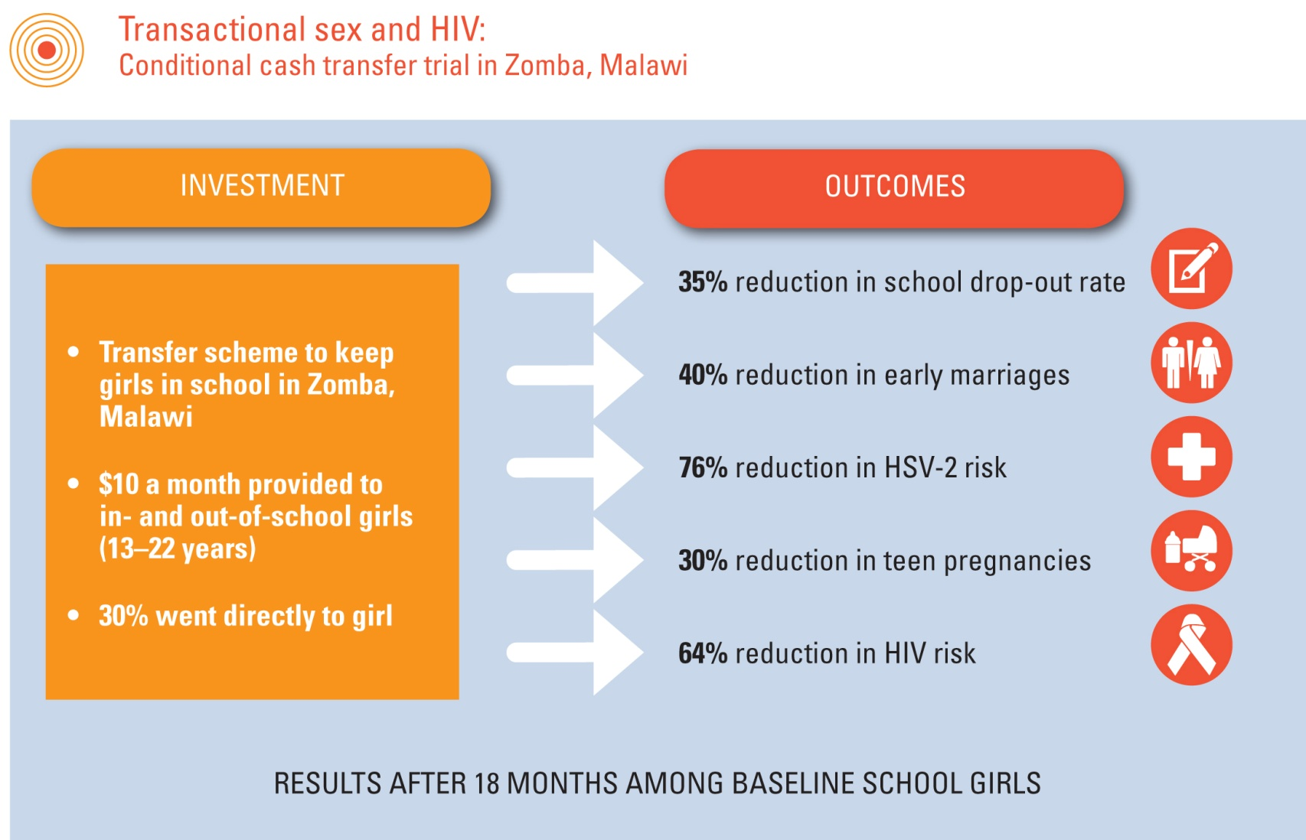
Cash transfers and HIV
Source: Baird et al, Lancet, 2012
Notes:
Evidence of impact of cash transfers on HIV...
This study from Malawi (Baird et al 2012) is an important one, which found a reduction in HIV and HSV-2 risk, as well as reduced school drop-out, early marriage and teen pregnancies.
There is more evidence on the impact of cash on HIV, but other studies have focused on intervention models that use cash as a direct conditional incentive to modify more proximal HIV-related behaviour, rather than as a means to address more upstream structural determinants of risk.

Slide 11

We need innovative combination approaches that can go to scale

Slide 12
Integrating prevention responses at a clinic level
HIV testing
Offer PrEP
PrEP continuation
PrEP as part of a comprehensive sexual and reproductive health service delivered in a youth friendly clinic

Slide 13

Integrating prevention responses at a clinic level
HIV testing
Offer PrEP
PrEP continuation
GBV screening integrated into
HIV testing
Community dialogues
PrEP as part of a comprehensive sexual and reproductive health service delivered in a youth friendly clinic
Clubs with an empowerment
curriculum

Slide 14

Multi-sectoral programming at scale

Slide 15
Girl-centred HIV prevention - conclusions
There is an unmet need for HIV prevention for adolescent girls and young women in sub-Saharan Africa.
Despite significant advances in scaling up treatment and prevention interventions, biomedical interventions alone will not achieve the ambitious targets for HIV prevention
There is a growing body of evidence that structural factors can be addressed within programmatic time frames
We need to combine these strategies to optimise the treatment and prevention cascade and evaluate at scale

Slide 16

Acknowledgements
James Hargreaves
Anne Stangl
Mitzy Gafos
Deborah Baron
Robyn Eakle
Shari Krishnaratne
http://strive.lshtm.ac.uk/
Iman Barre
Katherine Fritz
Kirsten Stoebenau
Joyce Wamoyi
Saidi Kapiga
Charlotte Watts
Saiqa Mullick

